Slide 1
Introduction to Tableau
Part 1
Notes:
Welcome back to Data Society! We have a great class ahead of us today.

Slide 2
Module completion checklist
Objective | Complete
Explain the need for Tableau and describe its features
Describe how data sources connect to Tableau
Import the given dataset into Tableau
Explain the concept of Relationships
Discuss the use of joins in Tableau

Slide 3
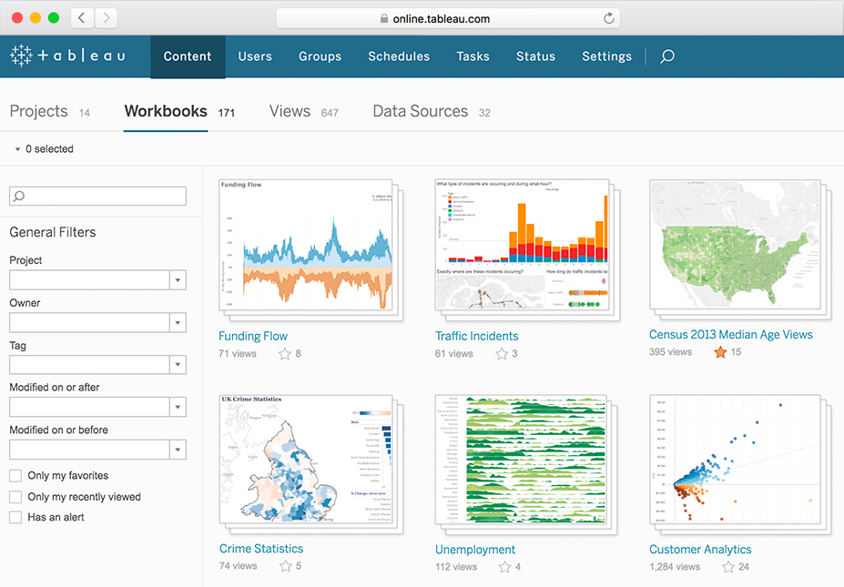
Why use Tableau?
It offers a quick and easy way to create interactive visualizations and explore data.
It is easy to integrate with multiple data sources.
It is compatible with OS X, Windows, and Linux.
It integrates with R and Python for advanced analysis.
Notes:
The purpose of this slide is to introduce some basic possible motivations behind using Tableau as a data visualization tool.

Slide 4
Excel vs. Tableau
Parameters | Excel | Tableau
Purpose | Spreadsheet application used for manipulating data | Visualization tool used for data analysis
Usage | Most suitable for statistical analysis of structured data | Most suitable for quick and easy representation of large datasets, which helps resolve big data issues
Performance | Moderate speed, with no option to speed up | Moderate speed, with options to optimize and enhance the progress of an operation
Security | Relatively weak (compared with Tableau); needs regular updates | Extensive options to secure data without scripting; row-level security and permissions are built-in.
Notes:
The purpose of this slide is to provide an overview comparison of a few parameters in Excel vs. Tableau.

Slide 5
Excel vs. Tableau, cont’d.
Parameters | Excel | Tableau
User Interface | Macro and Visual Basic scripting knowledge required to maximize tool potential | Tool can be used without any coding knowledge
Business Need | Best for preparing one-off reports with small datasets | Best while working with big data
Products | Bundled with MS Office Tools | Comes with different versions, such as Tableau server, cloud, and desktop
Integration | Integrates with ~60 applications | Integrates with ~250 applications
Real-time Data Exploration | You need to have an idea of where your data leads to generate insights. | You are free to explore data without seeking concrete outcomes, especially with features like drill-down and data blending.
Notes:
The purpose of this slide is to provide an overview comparison of a few more parameters in Excel vs. Tableau.

Slide 6
Module completion checklist
Objective | Complete
Explain the need for Tableau and describe its features
Describe how data sources connect to Tableau
Import the given dataset into Tableau
Explain the concept of Relationships
Discuss the use of joins in Tableau

Slide 7
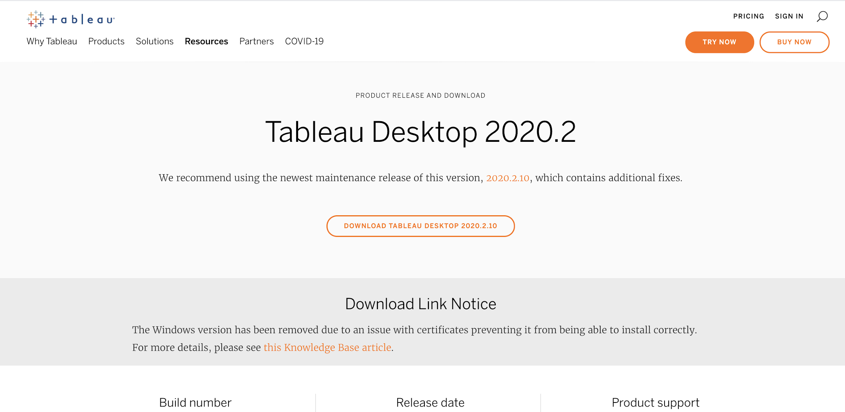
Installation
The Tableau Desktop version we have used during development is 2020.2.19, available here: Tableau Desktop 2020.2.19.
Notes:
The purpose of this slide is to direct students to the version of Tableau Desktop they will be using to complete the exercises in this portion of the course.

Slide 8
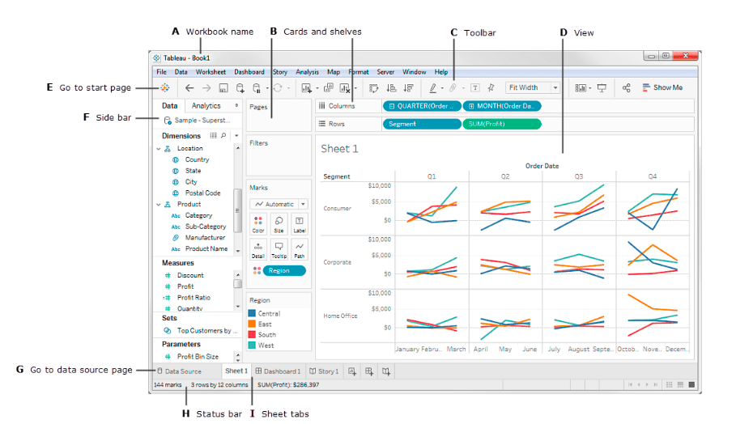

Tableau overview
Click the Tableau logo to bring up Connect panel
source: tableau.com
Notes:
The purpose of this slide is to point out the menu and pane structure of a Tableau workbook window. EXPLAIN that it will be easier to demonstrate what each portion does in a few minutes, after importing a dataset. To do so, INSTRUCT students to click on the Tableau logo button in the upper-left corner to open the Connect panel.

Slide 9
Module completion checklist
Objective | Complete
Explain the need for Tableau and describe its features
Describe how data sources connect to Tableau
Import the given dataset into Tableau
Explain the concept of Relationships
Discuss the use of joins in Tableau

Slide 10
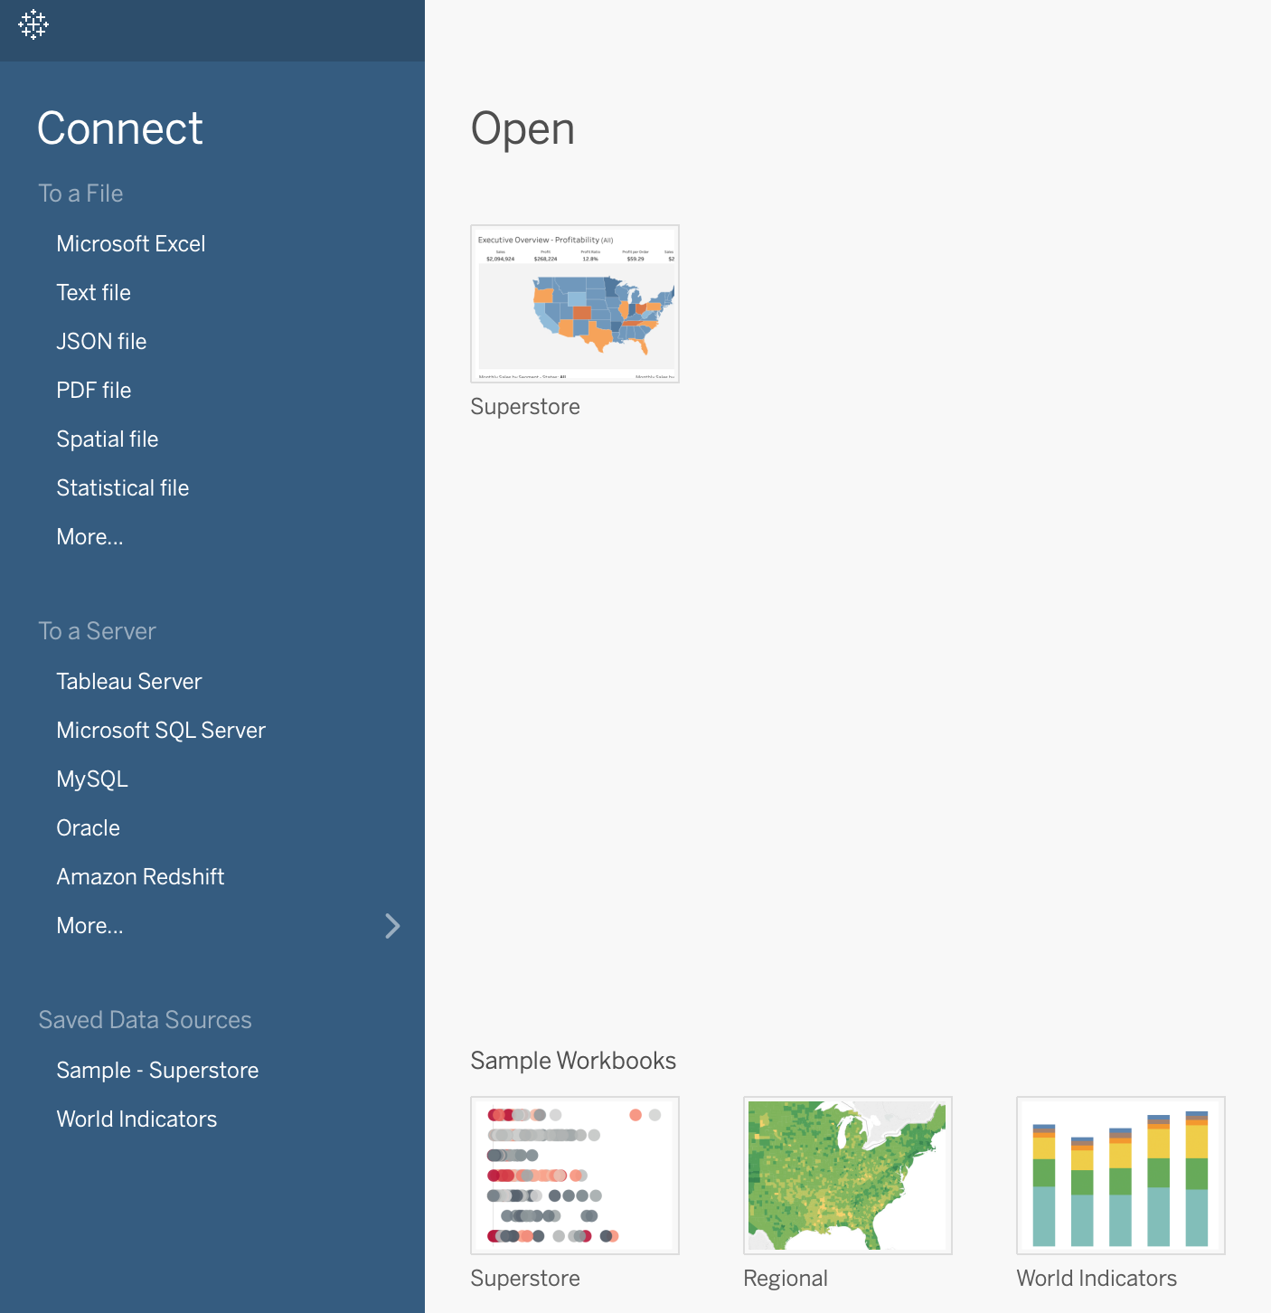
Importing data
Import data with the Connect panel.
Supports multiple formats such as:
Microsoft Excel (.xlsx).
Text (.txt, .csv).
JSON (.json).
PDF (.pdf).
R data format (.RData).
Supports Database Connections such as:
MySQL.
Oracle.
Redshift.
Notes:
The purpose of this slide is to define the different data types and database connections Tableau supports from the Connect panel.

Slide 11
Import world data : CSV
Let’s import some pieces of the world dataset today and see what sort of insights we can reveal.
Click the “More...” item to browse your local CSV files.
Notes:
The purpose of this slide is to instruct students to import a few CSV files for manipulation.

Slide 12
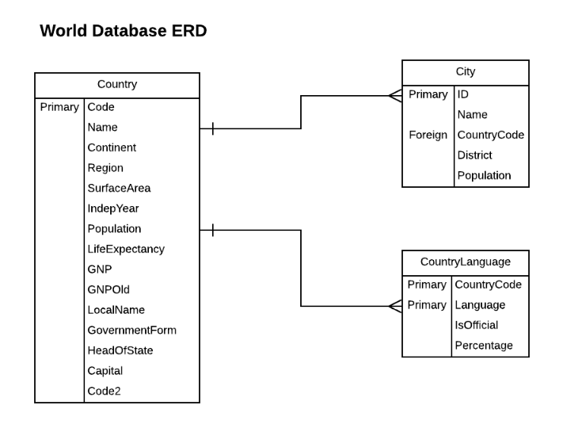
World database
For now, import the following three CSV files:
country.csv
city.csv
countrylanguage.csv
We’ll use the other CSV files during our Exercises.
Notes:
The purpose of this slide is to provide a schematic overview of the components of the world database students will be manipulating in this module.

Slide 13
Module completion checklist
Objective | Complete
Explain the need for Tableau and describe its features
Describe how data sources connect to Tableau
Import the given dataset into Tableau
Explain the concept of Relationships
Discuss the use of joins in Tableau

Slide 14
Joining datasets using Relationships
It is often necessary to combine data from multiple places - different tables or even data sources - to perform a desired analysis.
Tableau has introduced a feature called Relationships to minimize the amount of data pre-processing required to visualize related datasets in multiple ways.
To explore some of the concepts and features of Relationships, we’re going to examine geospatial data from the World Database.
Notes:
The purpose of this slide is to introduce the Relationships feature, which has taken the place of joins in Tableau as the default option for combining datasets.

Slide 15
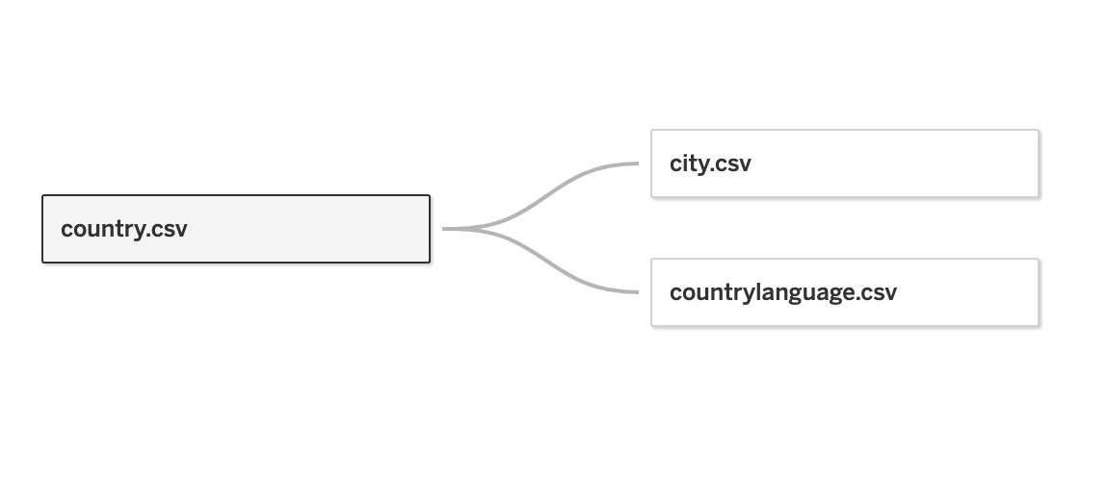
Relationships are contextual joins
A single relationship will support all join types at the same time.
For Measures, this means all values are always retained, even if they’re unmatched nulls (not missing values).
For Dimensions, relevant domains will be displayed across tables, and Tableau will display all values in the domain by default (even if there are no matching Measure values).
Notes:
The purpose of this slide is to provide examples of how relationships support various join types.

Slide 16
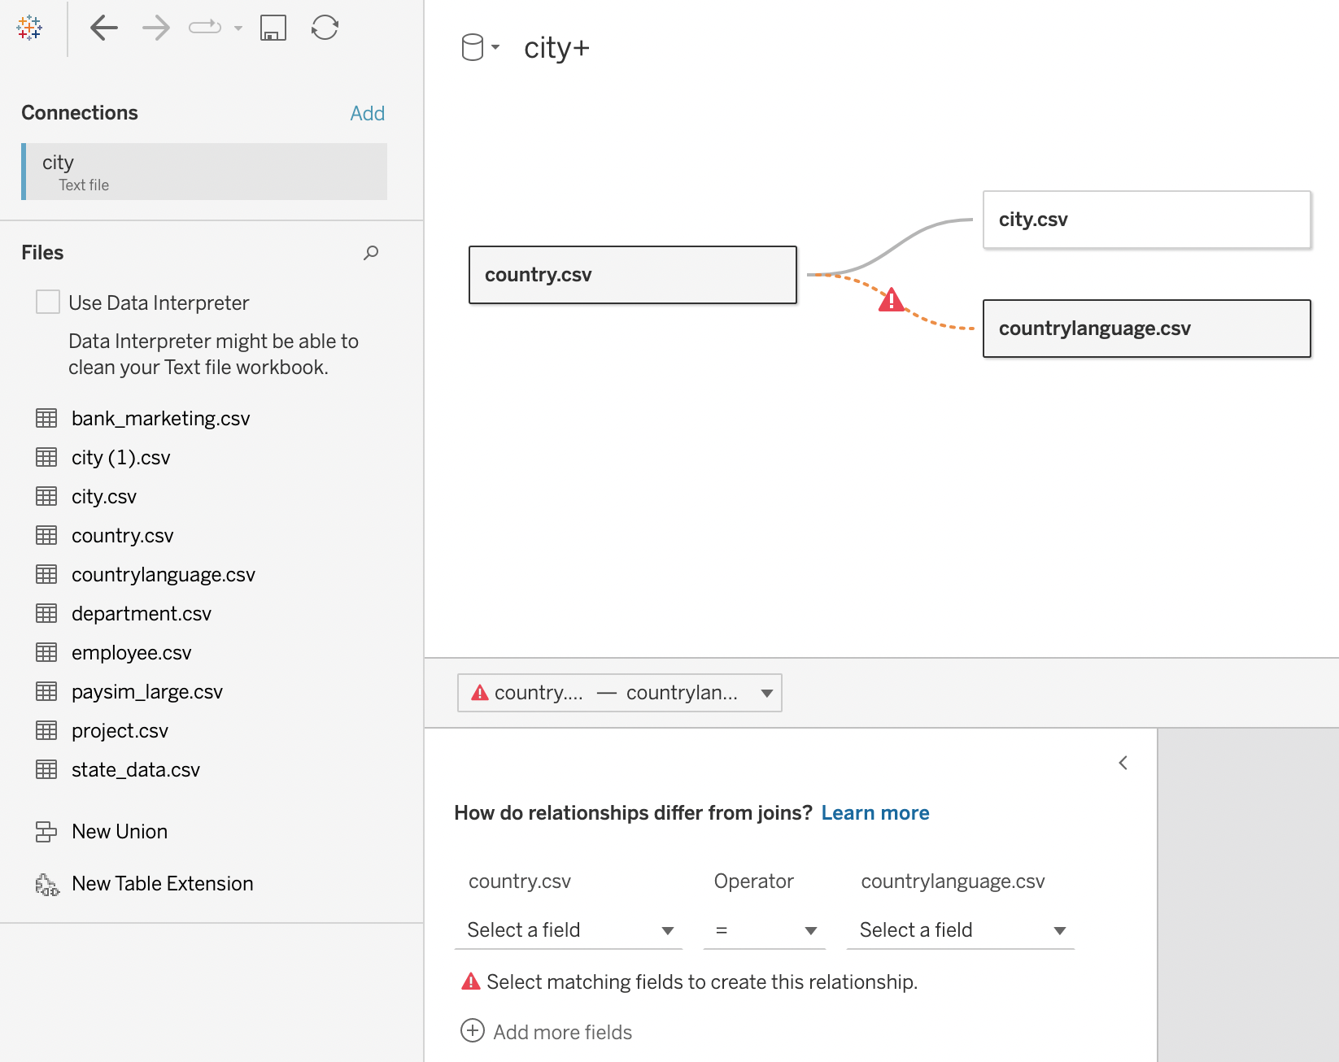
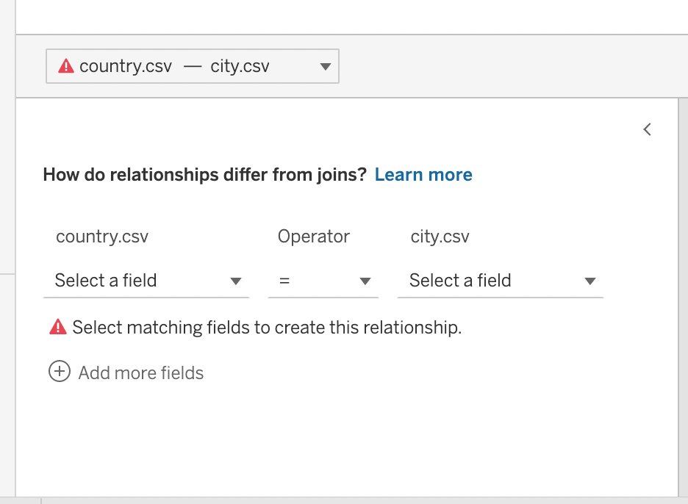
Select fields to create Relationships
Tableau creates Relationships after identifying the fields you want to use to establish relationships.
These fields should have common values that can be used to connect records from one table to another.

Slide 17
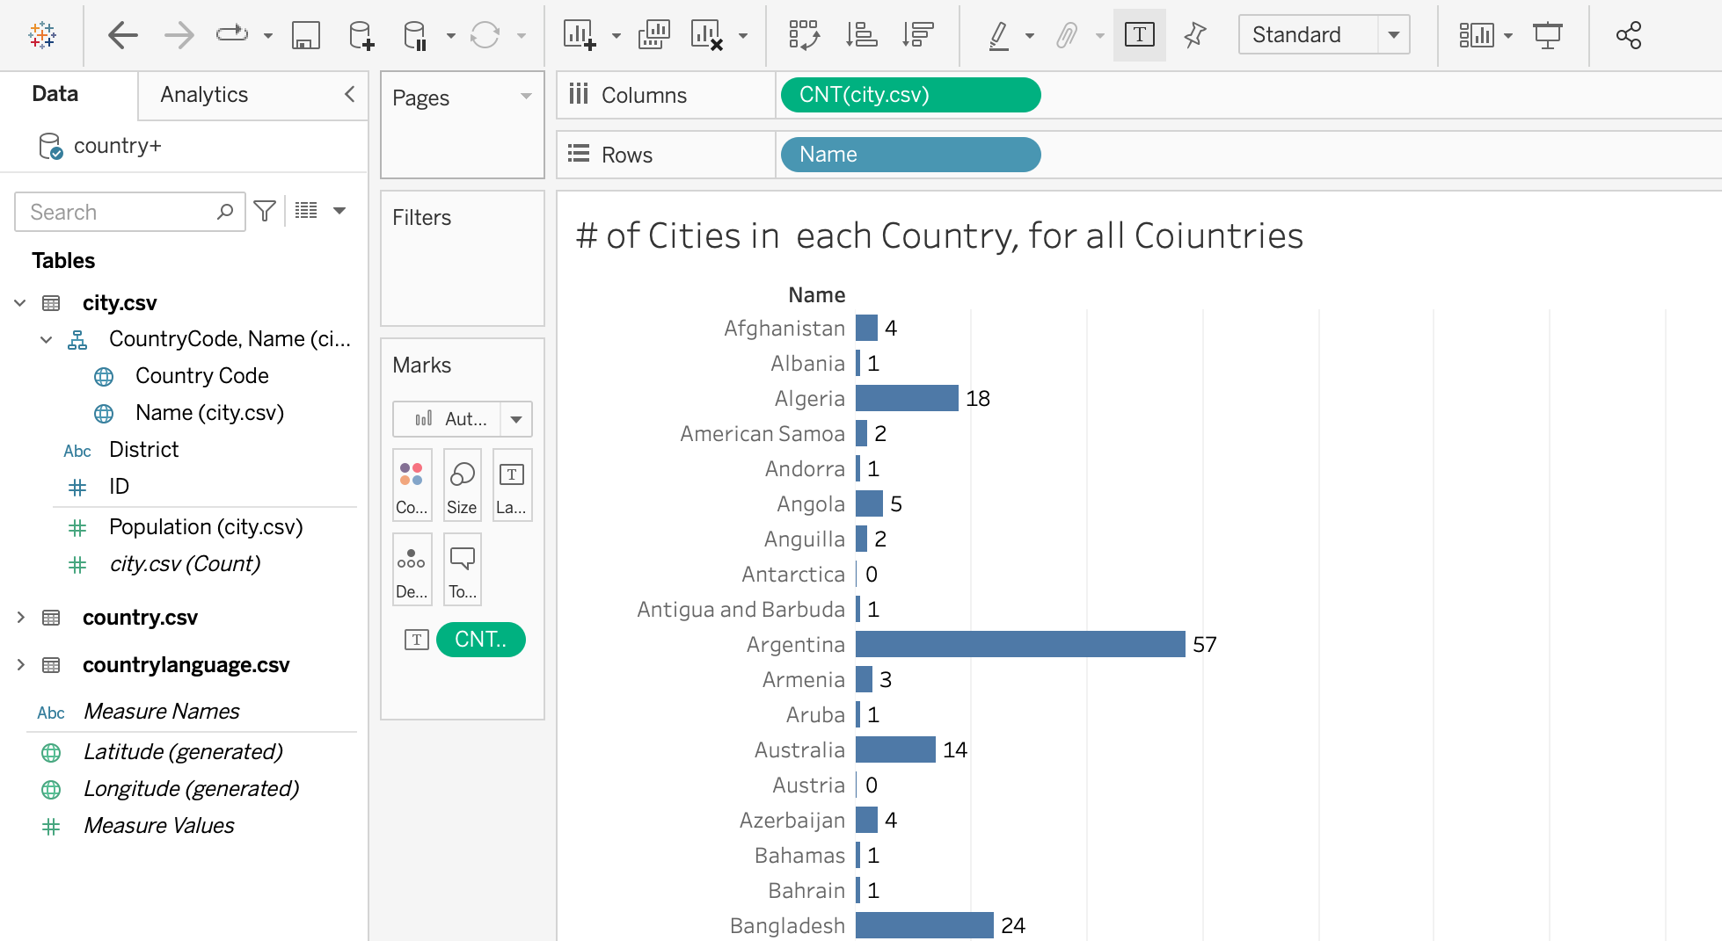
Unmatched measures as zero
Relationships allow for unmatched entries in one dataset to display as 0s.
Visualizing the count of cities by country shows all countries, even those without any corresponding cities.
Displaying all countries helps to avoid undercounting the number of countries.
Notes:
The purpose of this slide is to demonstrate the way unmatched measures will populate in Tableau.

Slide 18
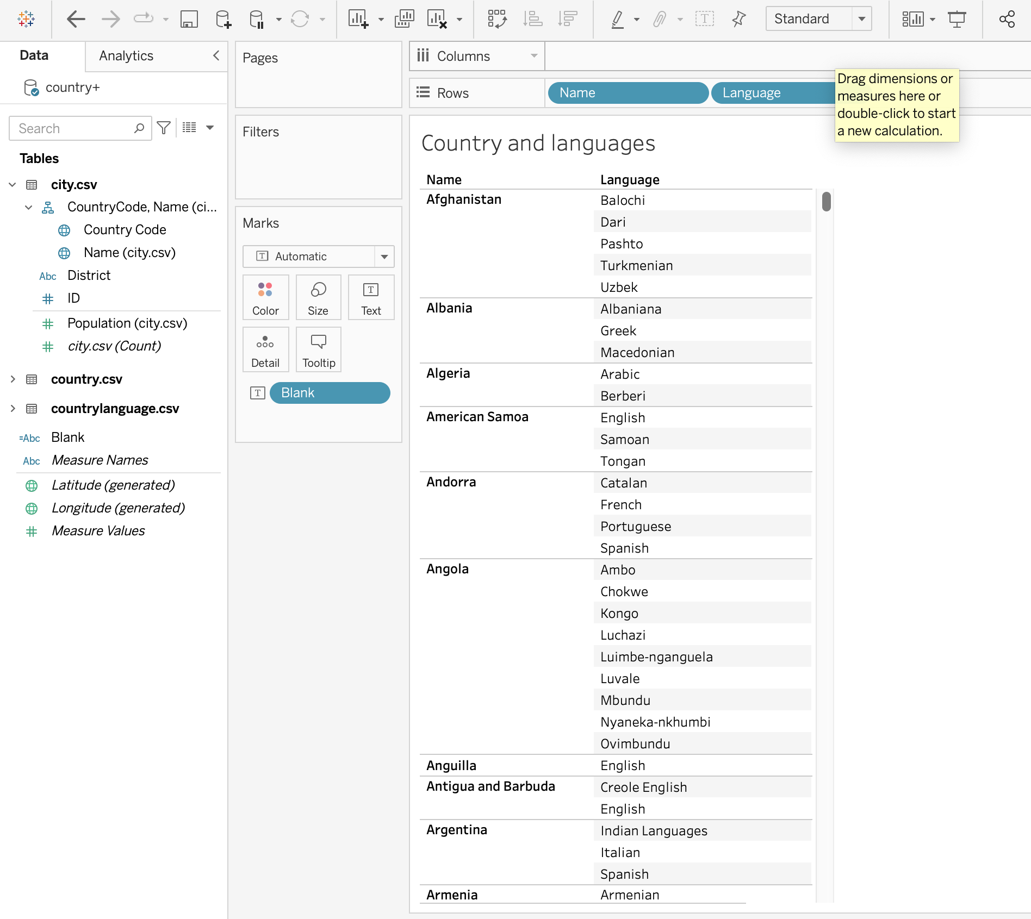
Relevant dimensions across tables
Additionally, Relationships affect how Dimensions will behave in visualizations involving different datasets.
When visualizing countries and languages, Tableau excludes territories like Antarctica, which may not have any languages.
Notes:
The purpose of this slide is to demonstrate how Tableau will treat certain data from a given set according to relevant dimensions.

Slide 19
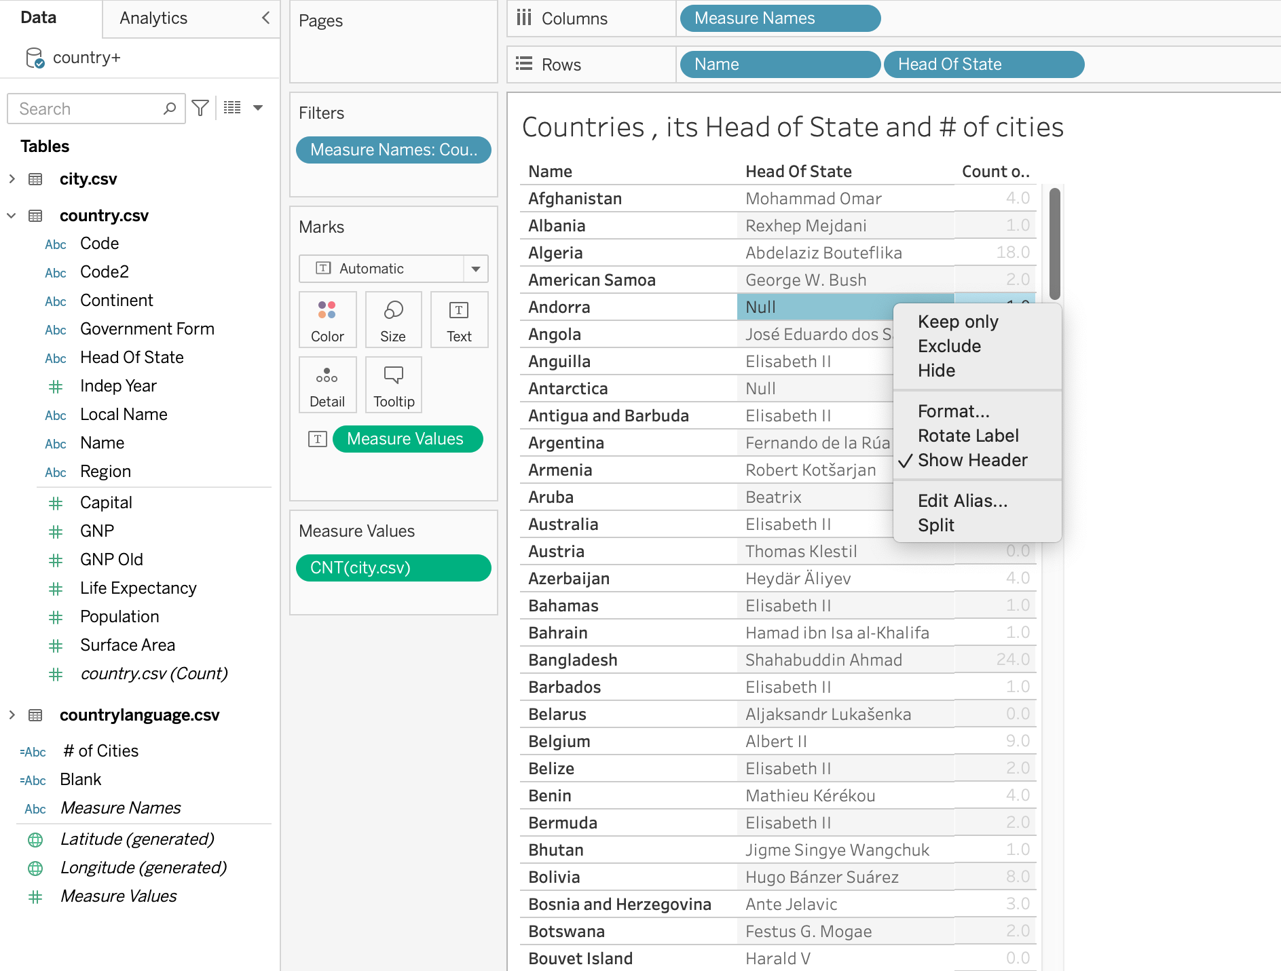
Retaining unmatched values
A null appears to represent a country a without Head of State (unmatched value)
Retaining these unmatched values through the Relationship again helps avoid undercounting the number of countries in total.
Notes:
The purpose of this slide is to show how a null functions within the relationships feature of Tableau.

Slide 20
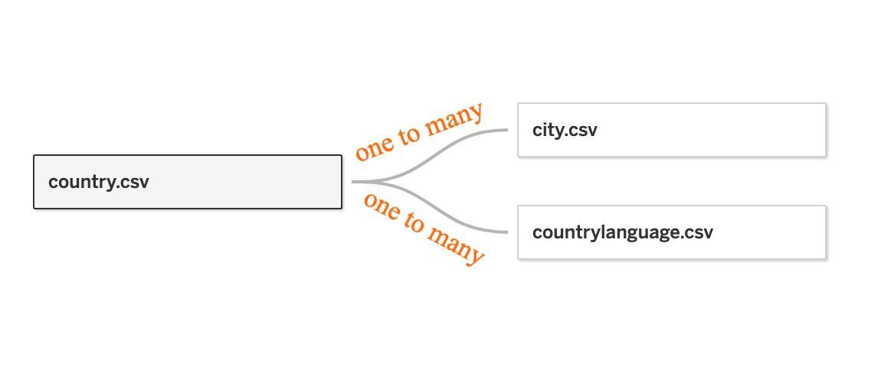
Relationships are smart aggregations
Aggregations will resolve to the Measure’s inherent level of detail from the source table.
Measures are only replicated across lower levels of detail in the visualization.
This means it is much less likely to end up with unnecessary, meaningless duplicated data in visualizations.
Notes:
The purpose of this slide is to show how Relationships offer a connection between datasets that requires less user input to clean than a traditional join.

Slide 21
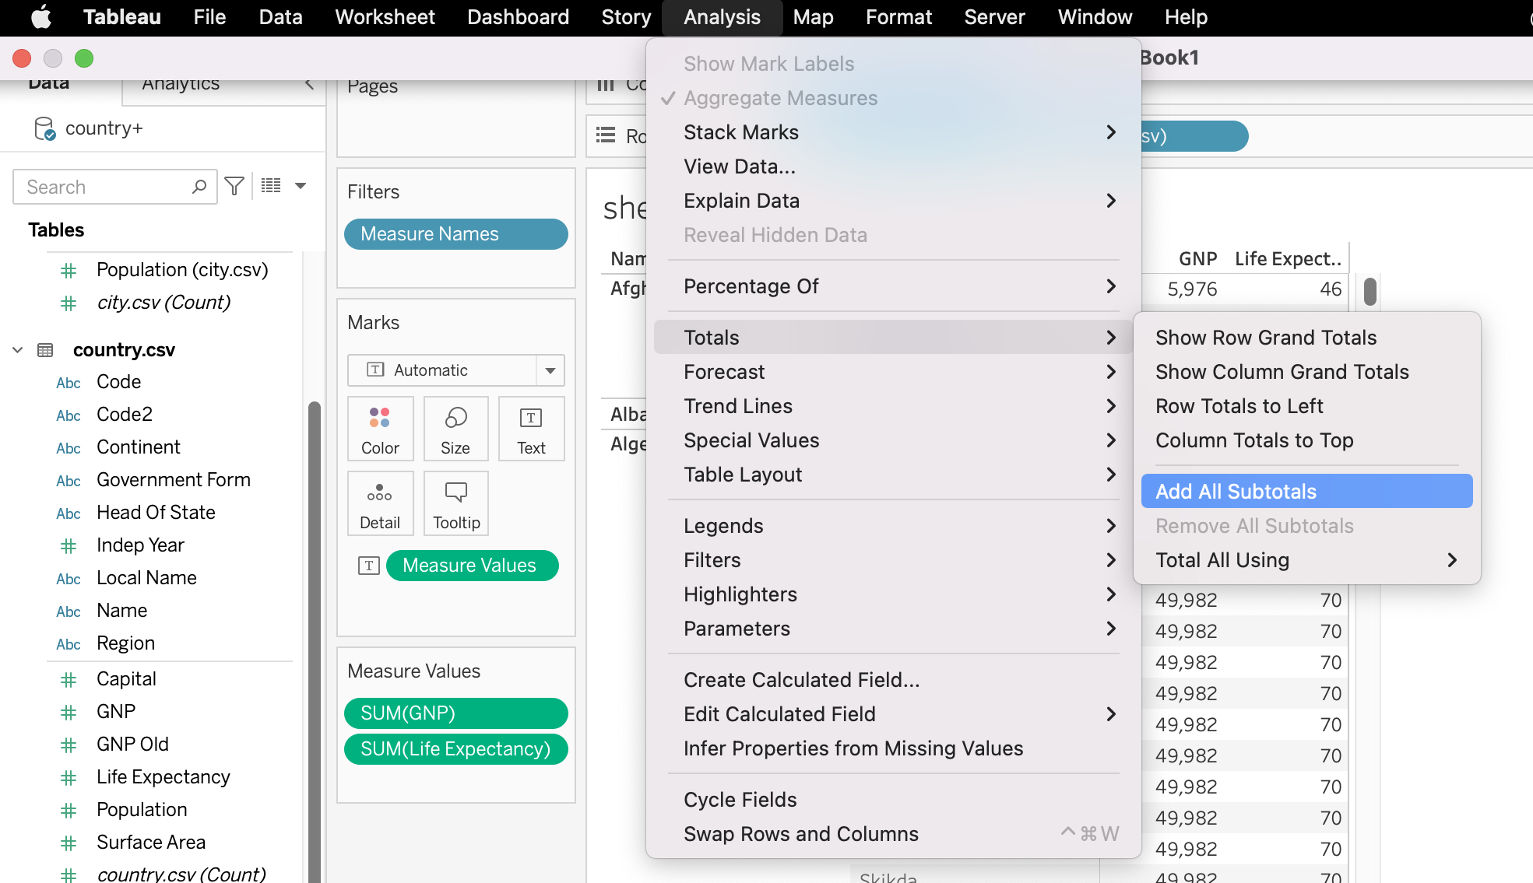
Relationships and level of detail
Relationships resolve to a Measure’s level of detail.
For example, each country is linked to some cities, a GNP, and life expectancy data.
When we add Country Name, City Name, GNP, and Life Expectancy, to a visualization, we obtain subtotals of GNP and life expectancy.
Notes:
The purpose of this slide is to discuss the relationship between a measure’s level of detail and Relationships. DEFINE level of detail (or LOD) as the way Tableau refers to the degree of granularity / disaggregation vs. aggregation in data.

Slide 22
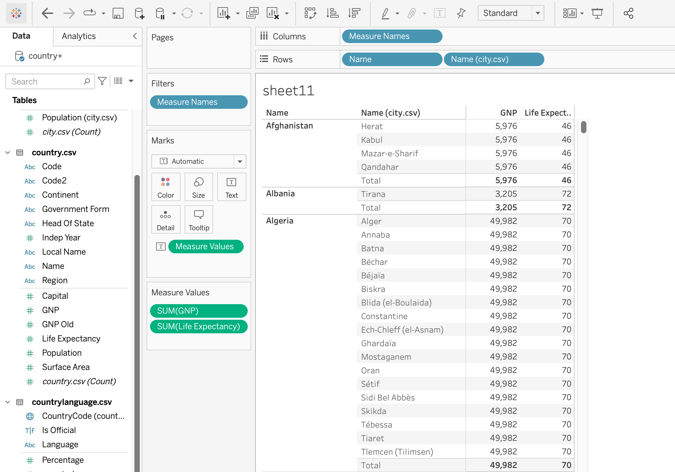
Relationships and level of detail, cont’d.
Tableau aggregates life expectancy and GNP in accordance to Country Name.
Notes:
The purpose of this slide is to discuss the relationship between a measure’s level of detail and Relationships.

Slide 23
Module completion checklist
Objective | Complete
Explain the need for Tableau and describe its features
Describe how data sources connect to Tableau
Import the given dataset into Tableau
Explain the concept of Relationships
Discuss the use of joins in Tableau

Slide 24
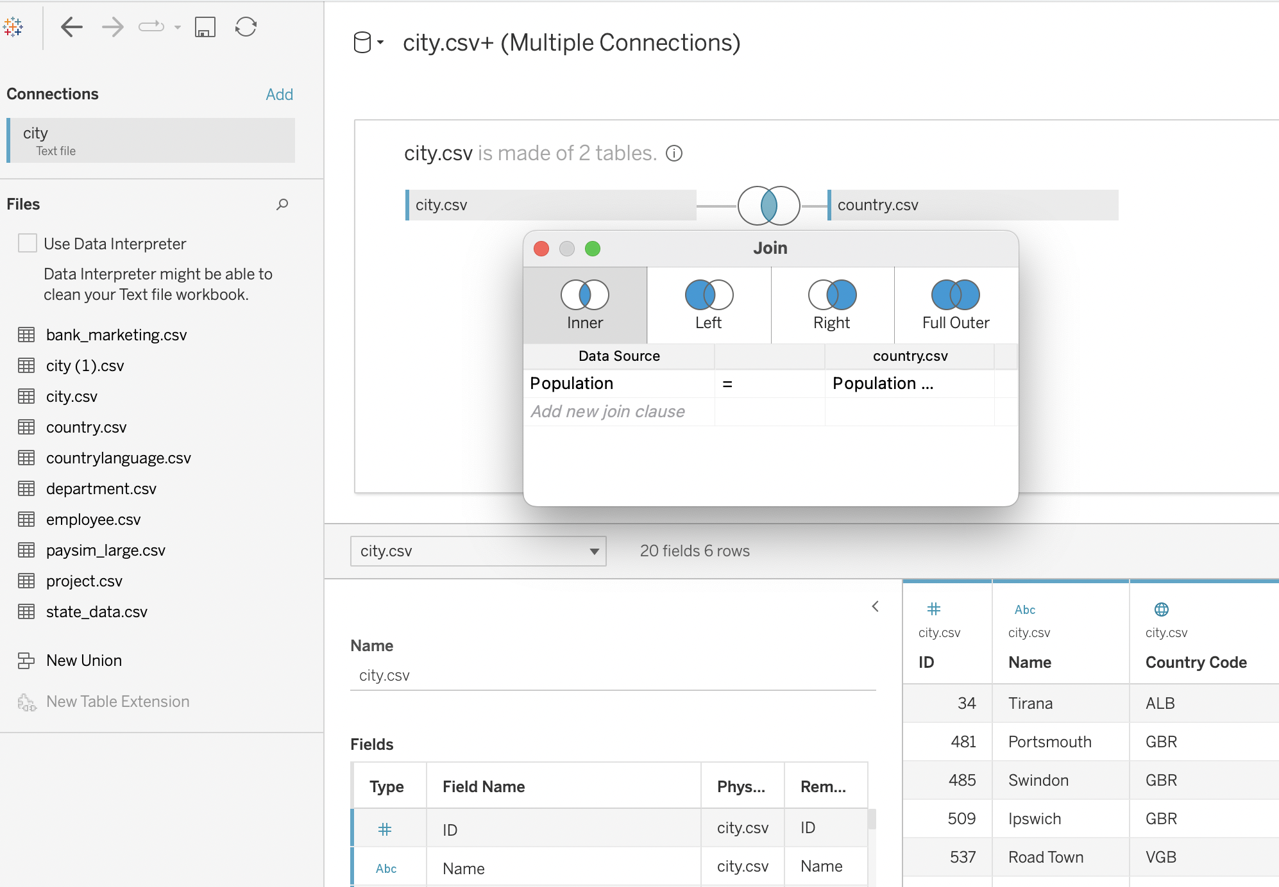
Manually joining datasets
Previously, Tableau utilized joins in order to merge and combine data.
It is still possible to join tables manually by specifying the precise variables the datasets will use as common keys, but this functionality is no longer the default.
Notes:
The purpose of this slide is to briefly point out the legacy Join feature that is still available, but no longer the default, in Tableau.

Slide 25
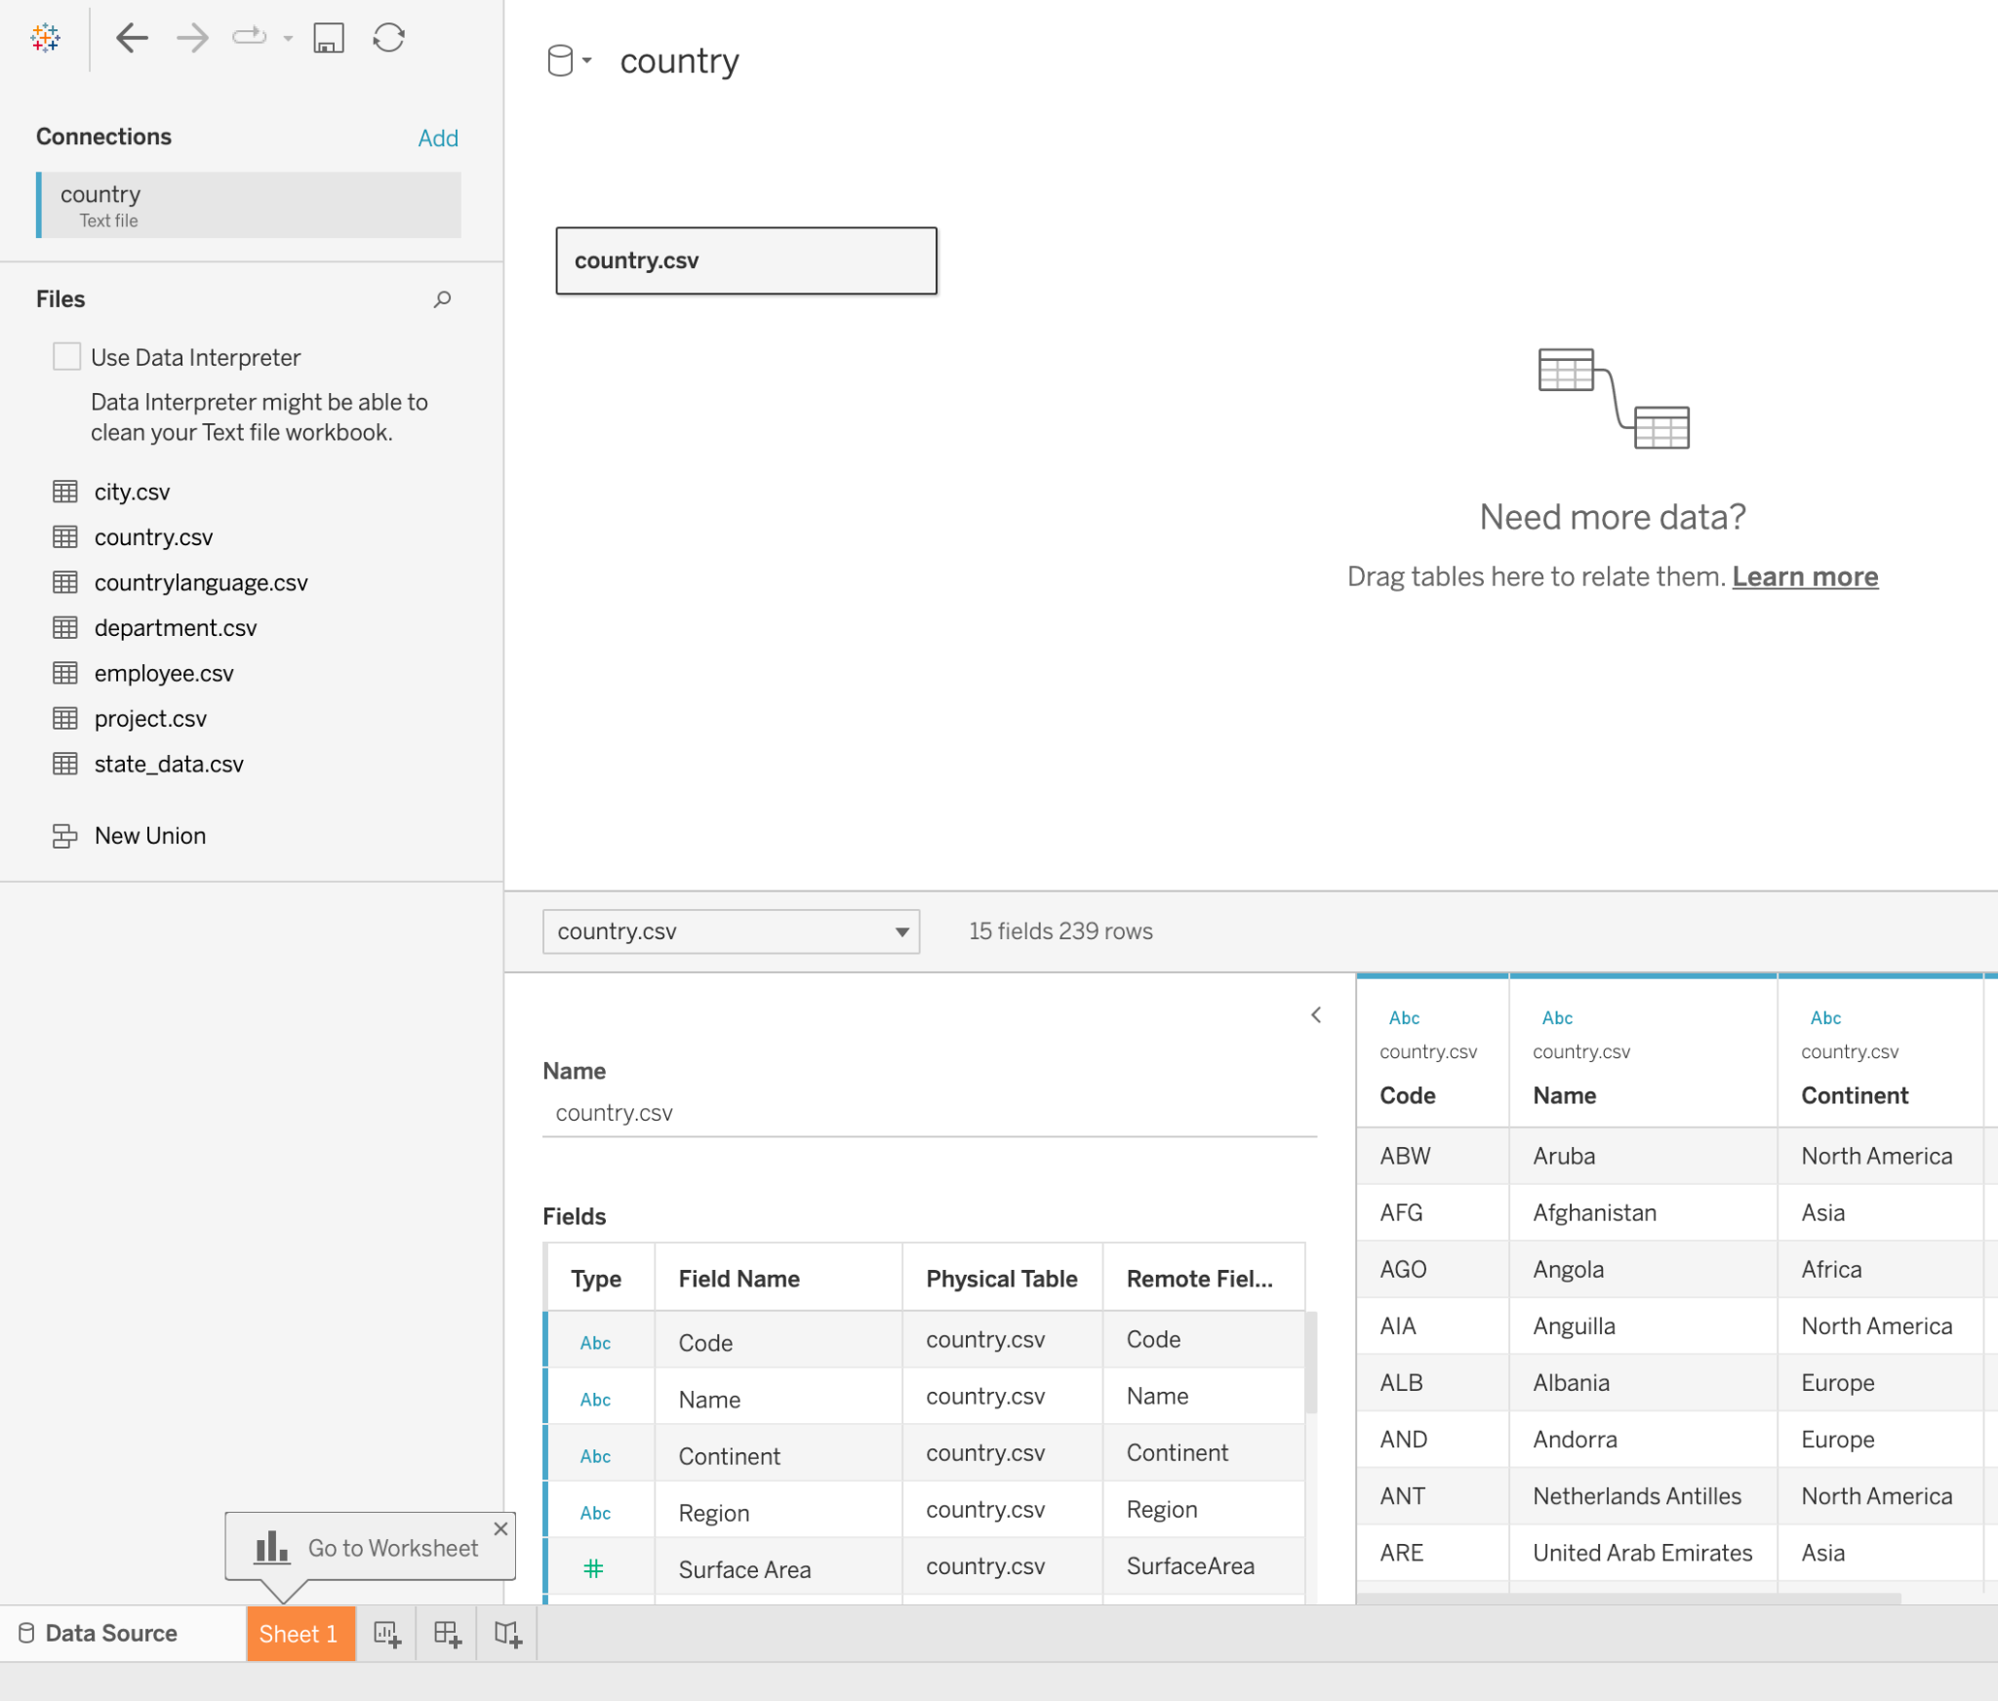
Joining tables using joins
To join tables using Relationships, we can use the default relationship canvas visible when viewing data sources.
But to join tables manually, we can access the legacy join canvas.
Notes:
The purpose of this slide is to illustrate how to open the join canvas. WALK THROUGH how to open the join canvas for this data source.

Slide 26
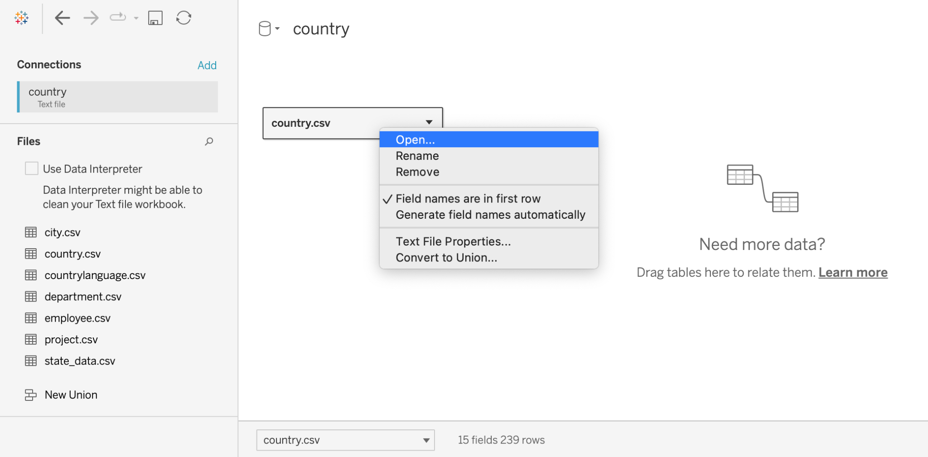
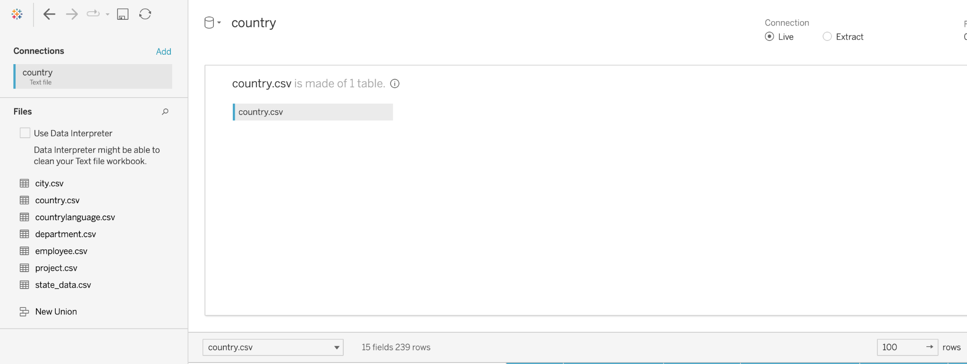
Joining tables using joins, cont’d.
To open the join canvas, select Open from the dropdown menu or double-click the first data source.
In the join canvas, we can specify exactly how we want the sources to relate to one another based on four basic types of joins.
Notes:
The purpose of this slide is to continue to illustrate how to open the join canvas. WALK THROUGH how to open the join canvas for this data source.

Slide 27

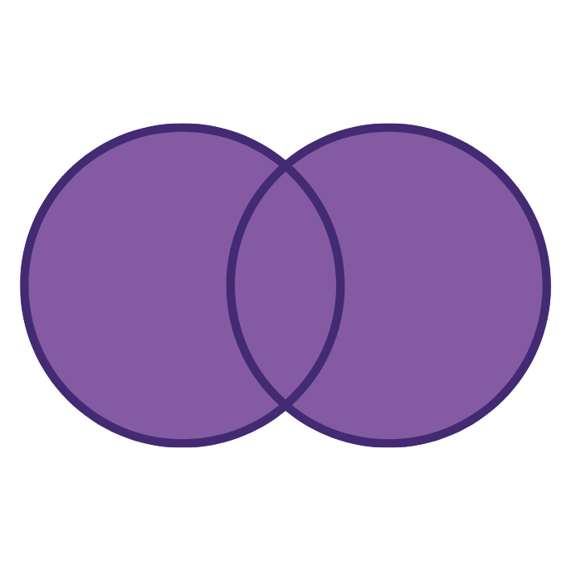
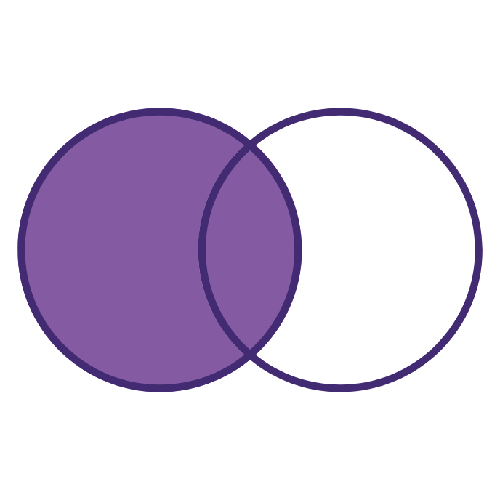

Types of joins
Table 1
Table 2
Table 1
Table 2
Table 1
Table 2
Table 1
Table 2
Inner join
includes matching records from both datasets
Full outer join includes all records from both datasets
Left outer join
includes all records from left dataset and matching records from right dataset
Right outer join
includes all records from right dataset and matching records from left dataset
Notes:
The purpose of this slide is to introduce the four basic types of joins that allow different data sources to be merged with one another.

Slide 28
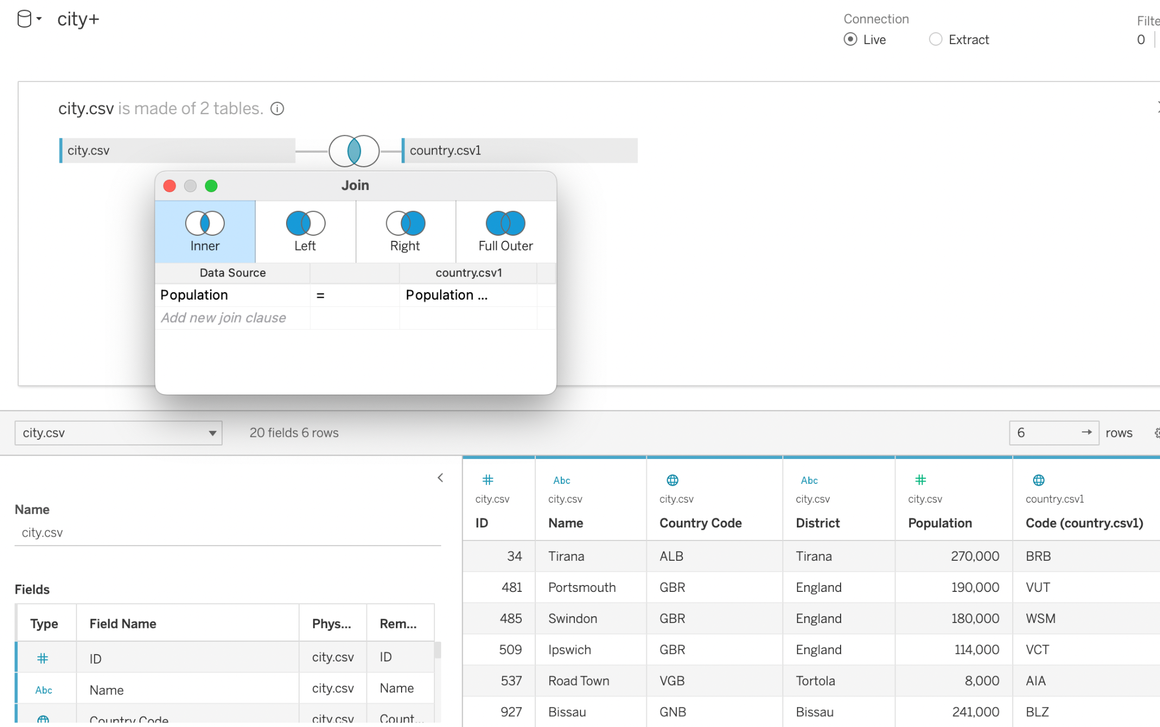
Best practices for using joins
Start by joining the country and city tables.
Here, inner join is the default join.
Consider including left or right outer join to get all of the records in one database, even if there are no matching data points.
Let’s try all types of joins on the country and city dataset.
Notes:
The purpose of this slide is to demonstrate how the auto-join feature may exclude important information by default. EXPLAIN that you will display the appropriate data (like country names) only by selecting the appropriate join.
The auto join doesn’t work in some cases and it depends on how Tableau interprets the data - hence it’s always best to look at the data to find the joining attribute before joining the tables.

Slide 29
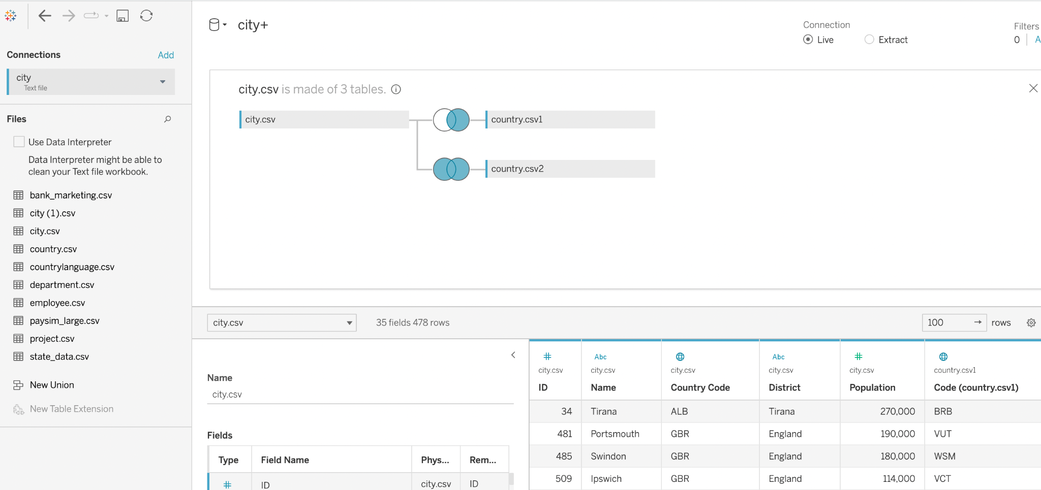
Join multiple datasets
Now join the countrylanguage dataset.
Does the order in which you import tables matter?
Why did you choose that order?
Why did you choose those types of joins?
Notes:
The purpose of this slide is to continue joining tables by adding the country language data. ASK the students the questions on the slide and COMMENT on their answers.
It’s ideal to perform the inner join to combine three datasets in this case, since we need the common records out of the three datasets for our analysis
The order doesn’t matter if we perform inner join and full outer join but it does matter in the case of left and right joins

Slide 30
Relationships vs. joins
Relationships | Joins
Describes how two, independent, logical tables(in logical layer) are related to each other (the tables are not merged) | Combine two tables into one (in physical layer)
Maintains the same level of detail in the data sources | Will sometimes duplicate data stored at differing levels of detail
All measures are kept, even the ones that do not match | Some measures get filtered
Do not allow us to decide on the join type | Can select the way we went to join the data

Slide 31
Knowledge check 1

Slide 32
Exercise 1

Slide 33
Module completion checklist
Objective | Complete
Explain the need for Tableau and describe its features
Describe how data sources connect to Tableau
Import the given dataset into Tableau
Explain the concept of Relationships
Discuss the use of joins in Tableau

Slide 34
End of Part 1
‹#›

